Slide 1
Bandwidth Delay Product
Dr.Mohammed Abdalla Mahmoud Youssif
1

Slide 2

2
Notes:
2

Slide 3
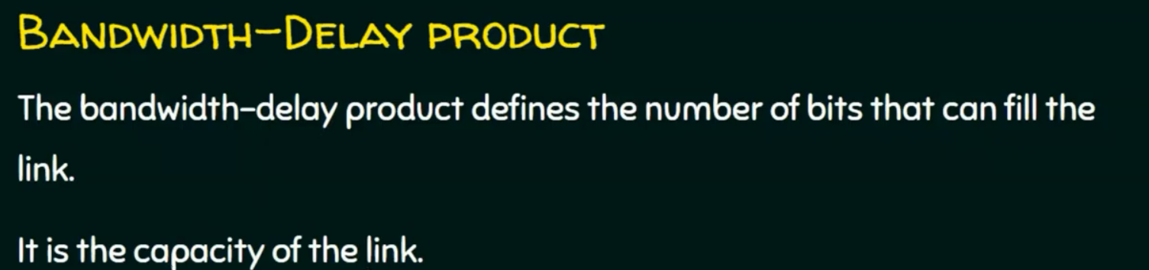
3
Notes:
3

Slide 4
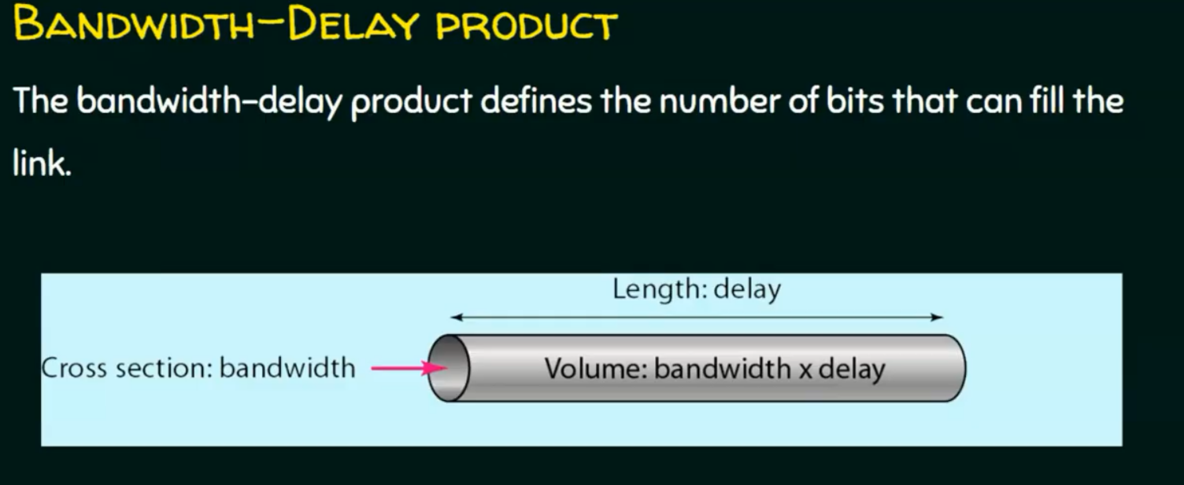
4
Notes:
4

Slide 5
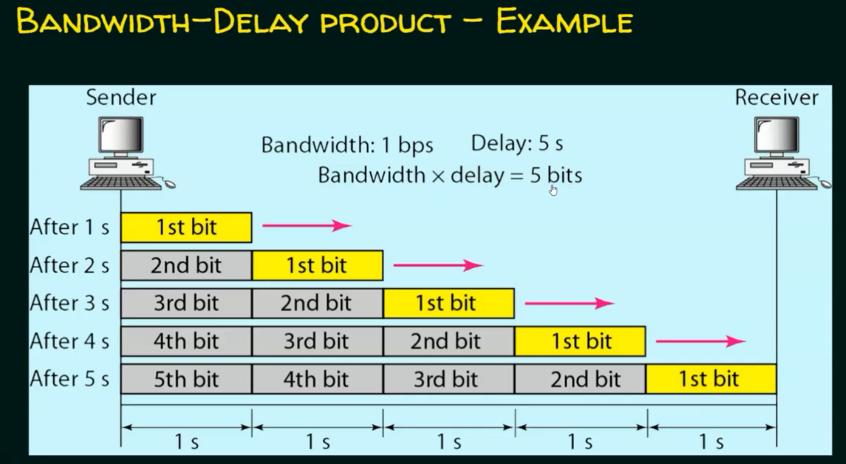
5
Notes:
5

Slide 6
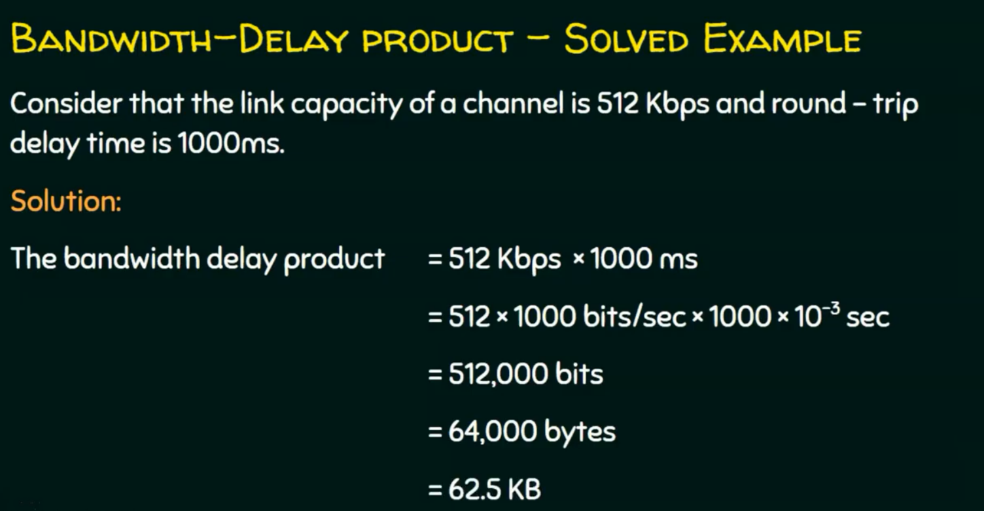
6
Notes:
6

Slide 7
Questions ?
7
Notes:
7

